Slide 1
A few met. highlights before
starting the new RUSSO™ session

Slide 2
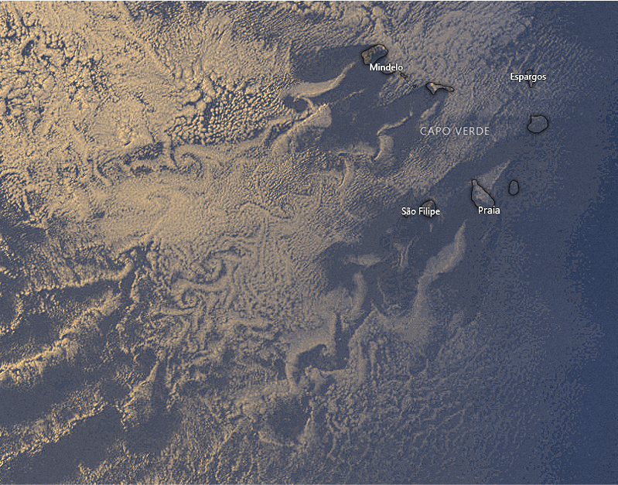
Lee vortices!
DON’T FALL IN THE TRAP:
They are not linked to any «boundary layer separation»

Slide 3
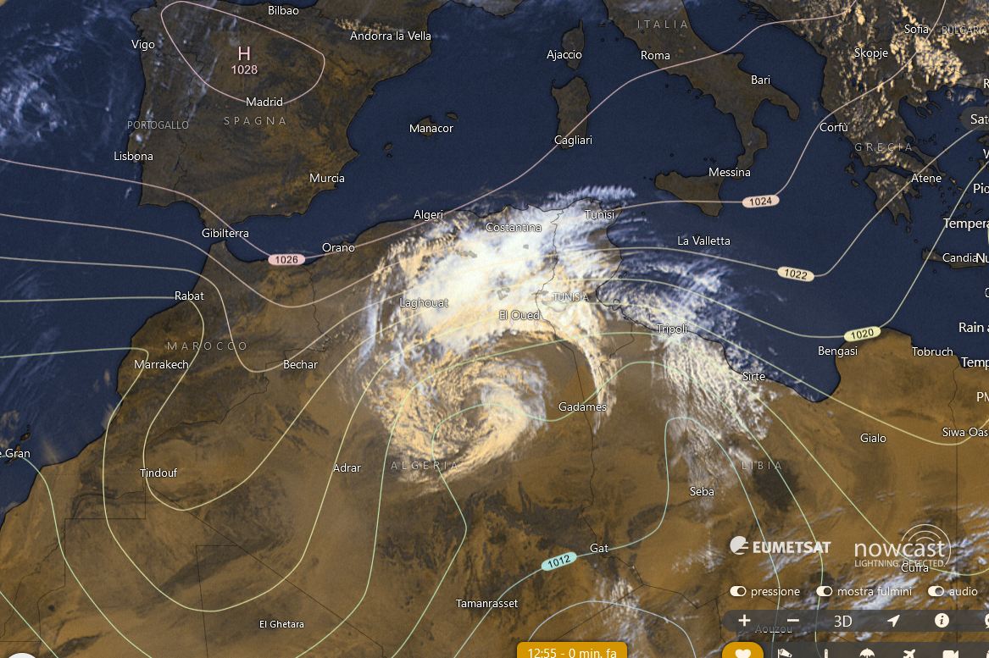
13.04
Coherent cyclonic structure over Algeria
→ PV+ anomaly

Slide 4
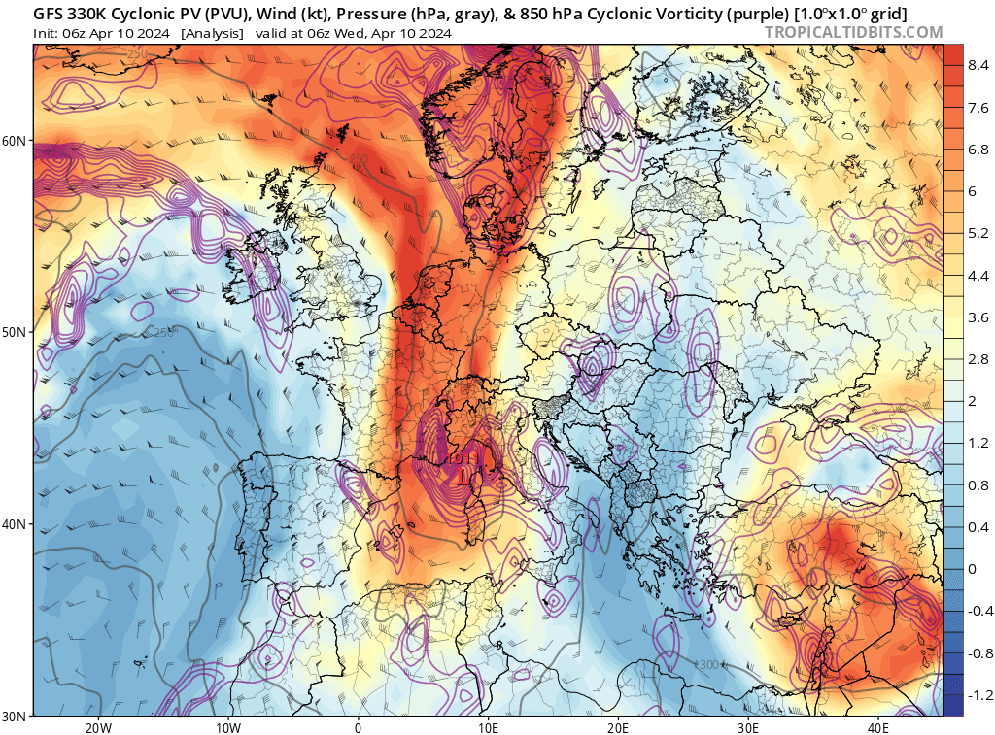
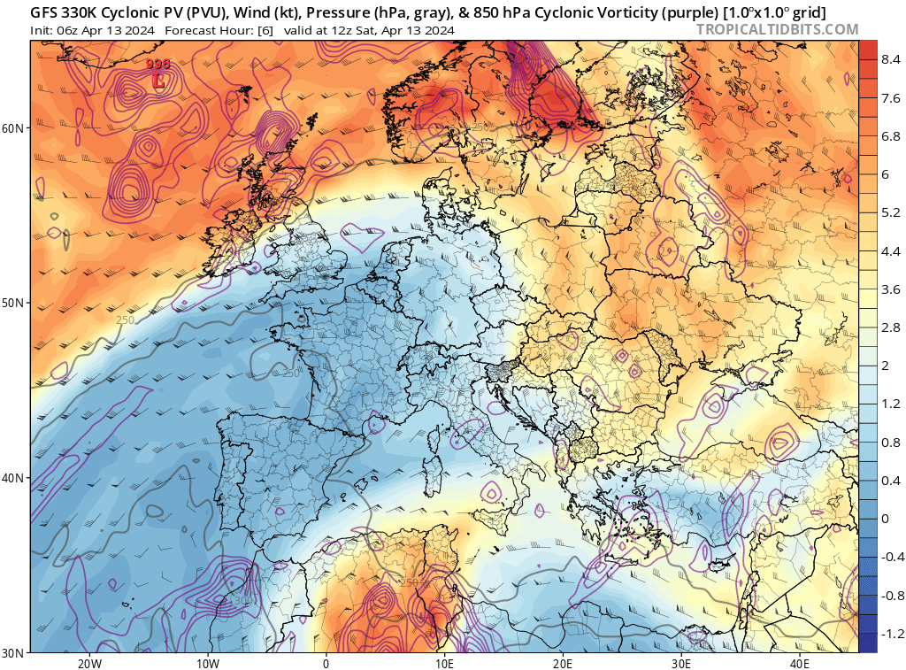
Source: tropicaltidbits.com

Slide 5
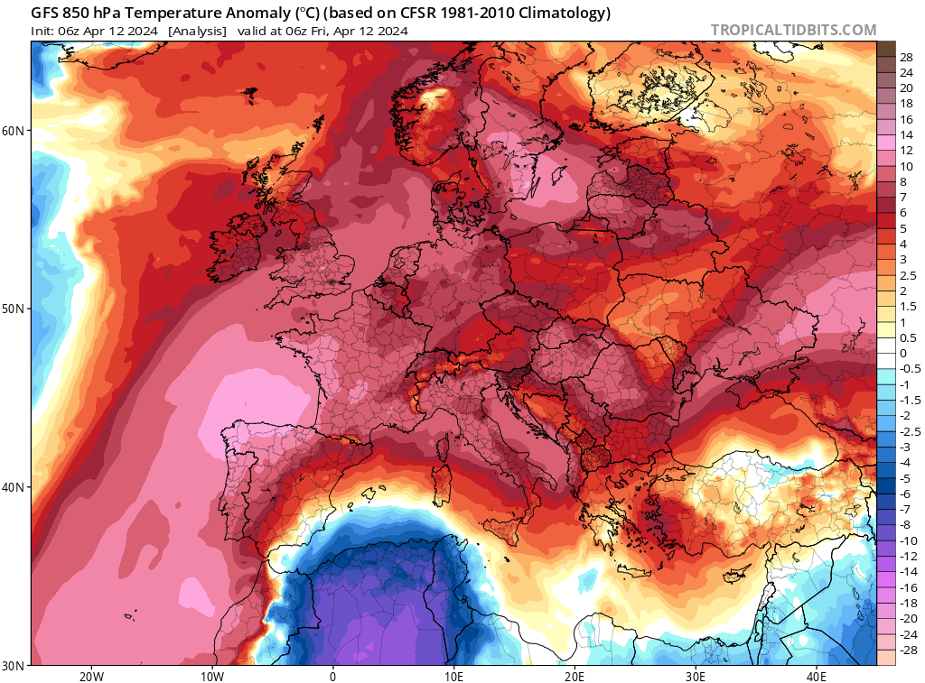

Slide 6
… actual topic for today:
Reacting to non-Uniform SST cOnditions

Slide 7
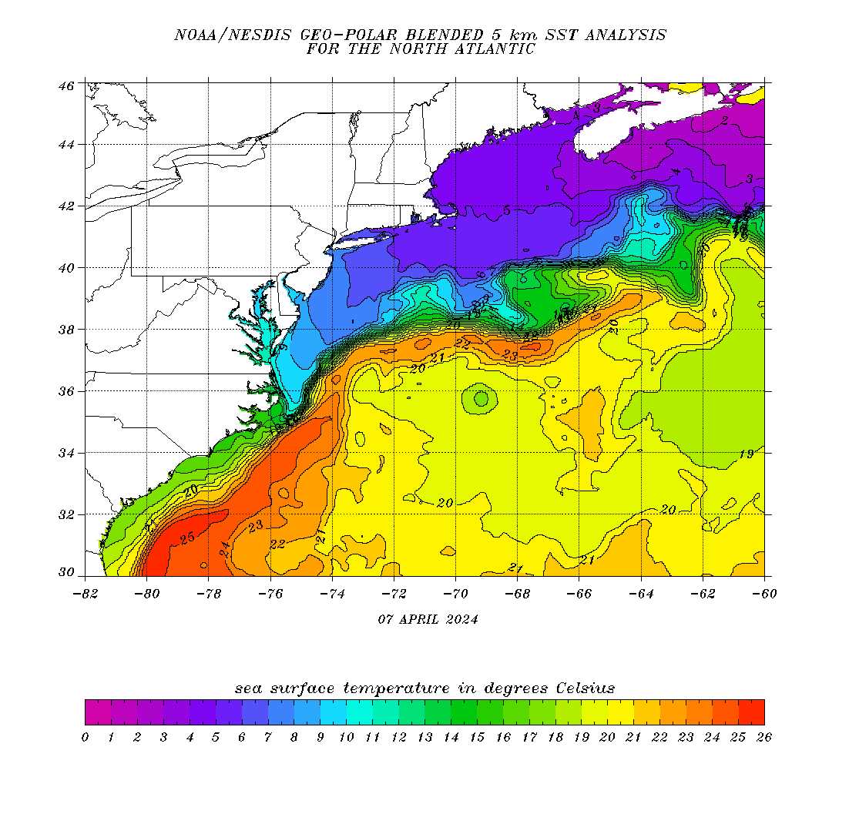
Brief summary on how the atmosphere responds to the strong SST gradients in the Gulf Stream
Notes:
https://eastcoast.coastwatch.noaa.gov/cw_geopolar_sst.php

Slide 8
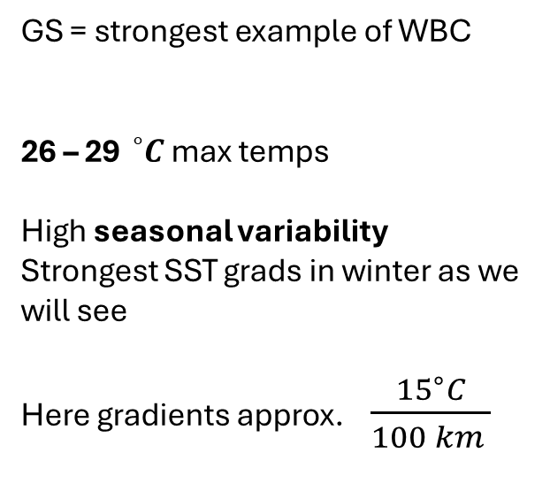
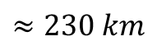
GS = strongest example of WBC
26 – 29${}_{}^{∘}C$ max temps
High seasonal variability
Strongest SST grads in winter as we will see
Here gradients approx. $\frac{{15}^{∘}C}{100 km }$
$$≈230 km$$
Notes:
https://eastcoast.coastwatch.noaa.gov/cw_geopolar_sst.php

Slide 9
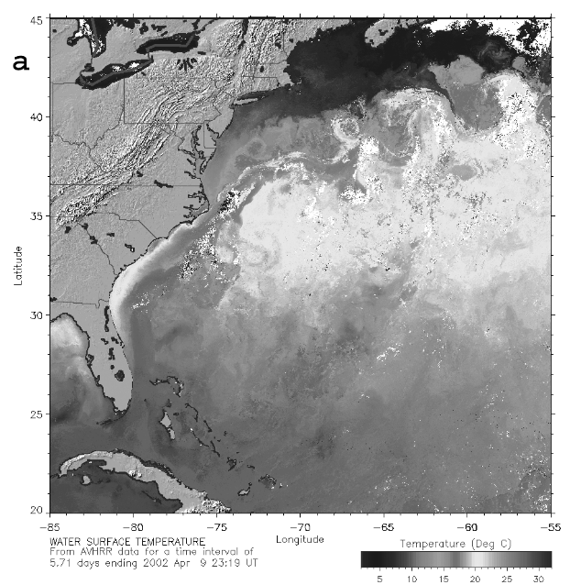
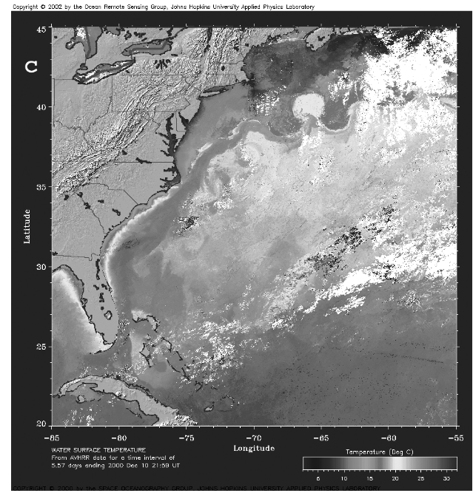
Very complex surface features → varying with time!
Two examples of SST as retrieved from AVHRR composites
Young and Sikora 2003

Slide 10
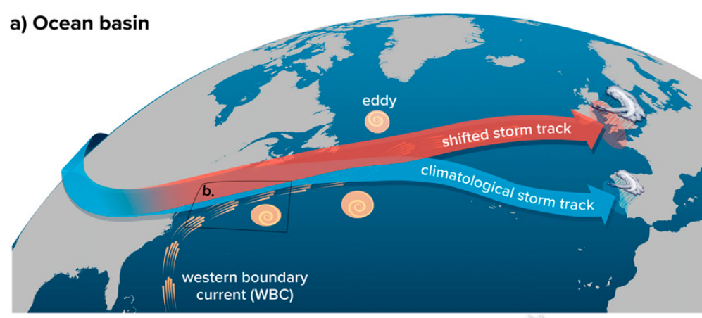
So strong that it can shift storm tracks!
Notes:
Mechanisms unveiled here are valid for other structures (such as Kuroshio and Agulhas)
Nonetheless everything starts from MABL
Diabatic heating corresponds to PV

Slide 11
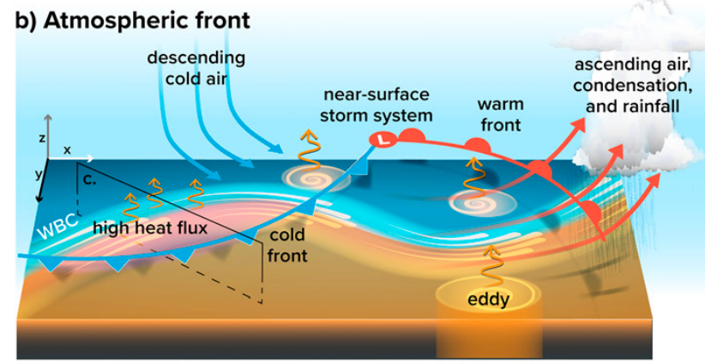
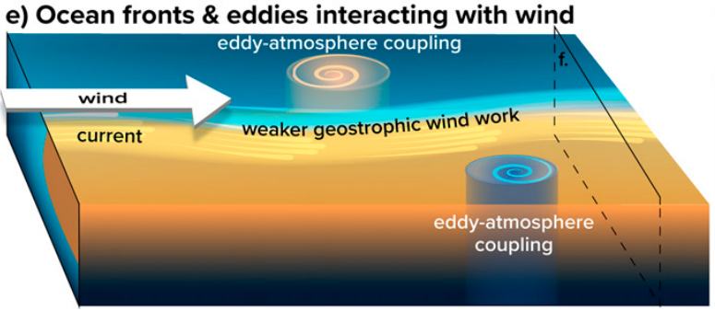
Large-scale circulation response strongly dependent on model resolution as for balance between HF and transient eddies
Interaction with atmospheric synoptic systems (some details later)
Effects of currents on surface shear stresses
CFB , submesoscale
… not dealt with here
Notes:
-> Mechanisms unveiled here are valid for other structures (such as Kuroshio and Agulhas)
Fronts are key, and are asctually the main drivers, in modulating the short time scale THF budget (1-2 weeks) → in contrast, if one smooths out synops, SST’ becomes the main contributor (1 month)
Role in convergence not clear : climatology linked to LAPL(SST), however there is debate started from QuikScat meas → explanation not from linear Ekman dynamics; do they contribute to time mean conv patterns?

Slide 12
Seasonality:
a broad perspective

Slide 13
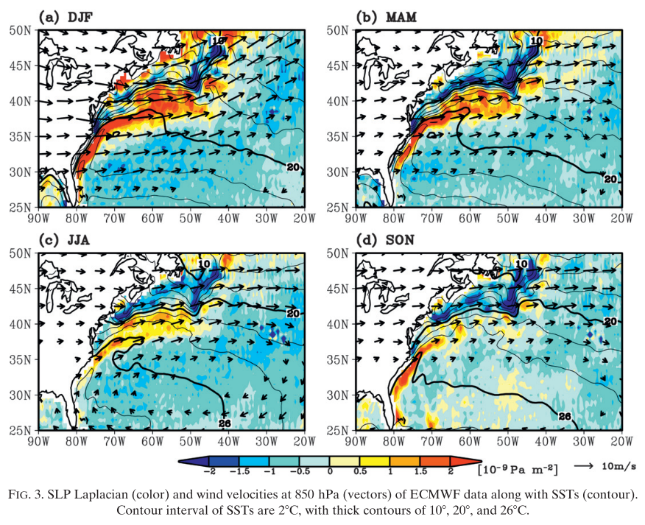
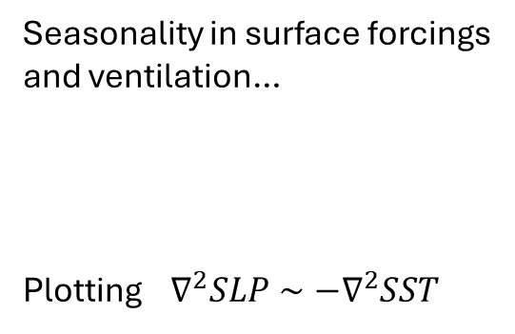
Seasonality in surface forcings and ventilation…
Plotting $∇^{2}SLP∼−∇^{2}SST$
Minobe et al. 2010

Slide 14
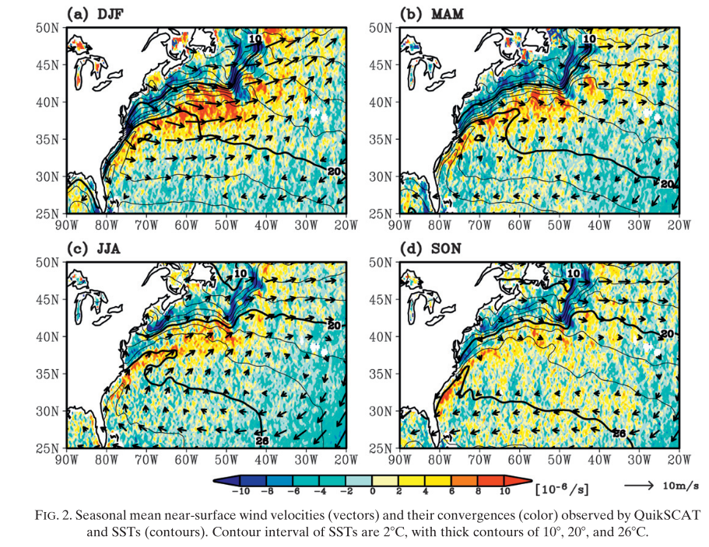
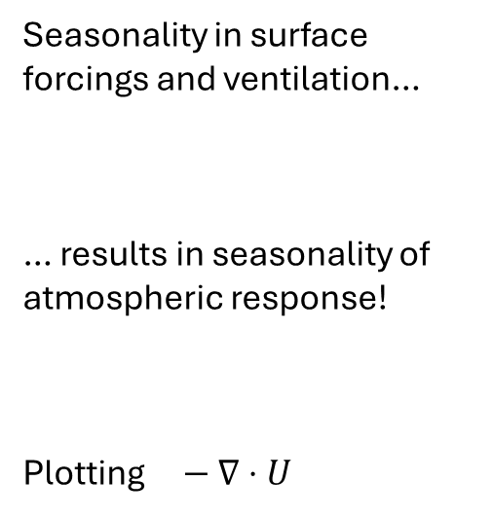
Seasonality in surface forcings and ventilation…
… results in seasonality of atmospheric response!
Plotting $− ∇⋅U$
Minobe et al. 2010

Slide 15
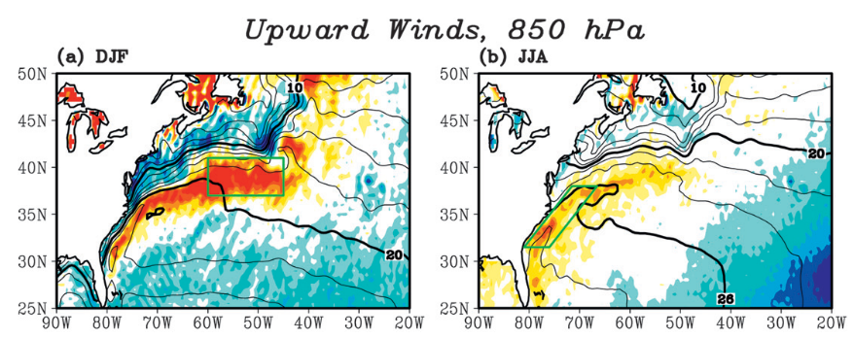
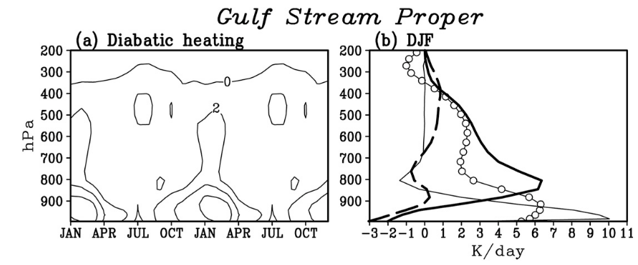
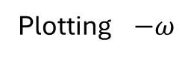
Plotting $−ω$
Seasonality in surface forcings and ventilation…
… results in seasonality of atmospheric response!
Heating rates from JRA-25/JCDAS from different components:
- Thick black: convective
- white circles: total diabatic
- Thin solid: total sensible
- Thick-dashed: large-scale condensation
Shallow convection dominates the scene in winter
Deep convection dominates in summer (not shown)
Minobe et al. 2010
Notes:
Transition from a low-SST region to high-SSt region is more prominent in low-level clouds

Slide 16
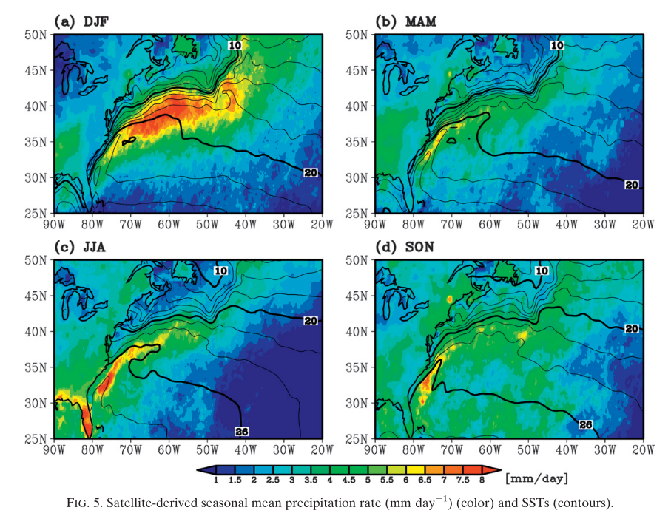
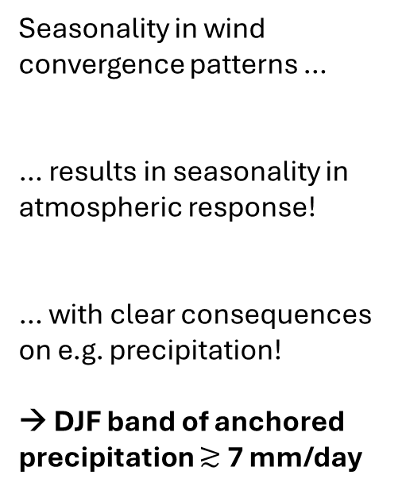
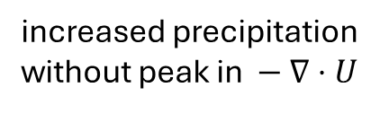
Seasonality in wind convergence patterns …
… results in seasonality in atmospheric response!
… with clear consequences on e.g. precipitation!
→ DJF band of anchored precipitation $≳$ 7 mm/day
increased precipitation
without peak in $− ∇⋅U$
Minobe et al. 2010

Slide 17
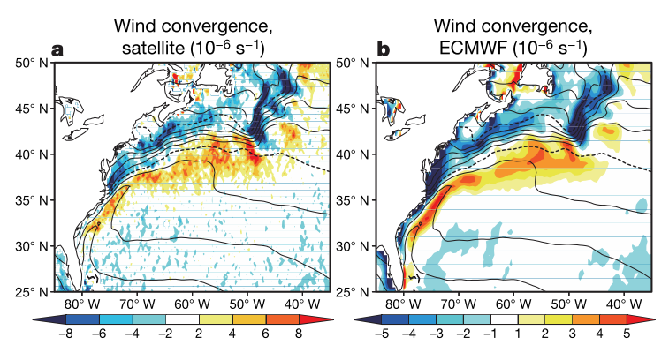
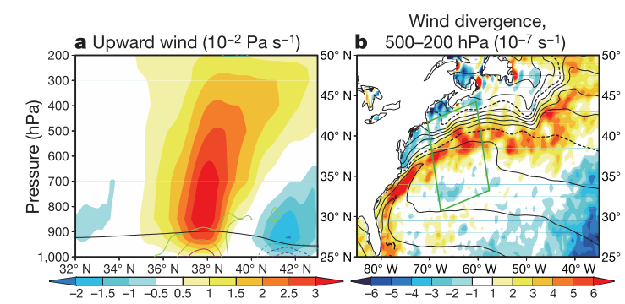
Not only MABL
GS is forcing the entire troposphere!
Notes:
« to a surface convergence field, there corresponds a reaction by the whole troposphere

Slide 18
Where were we?

Slide 19
Let’s reduce the scale of interest
→ ‘’Quick’’, small-scale MABL responses?

Slide 20
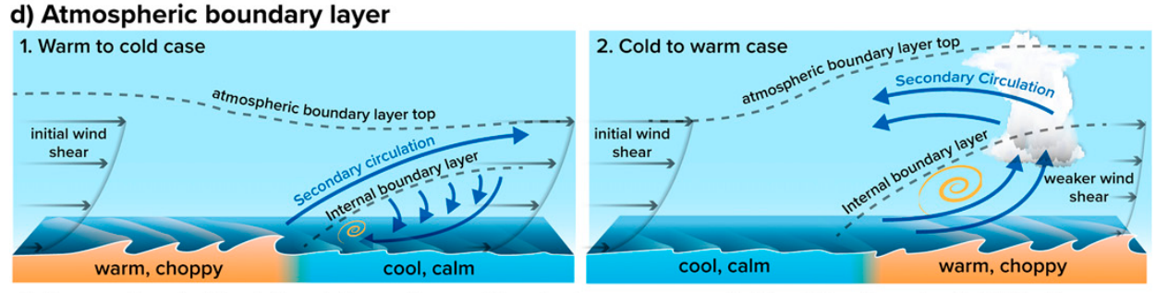
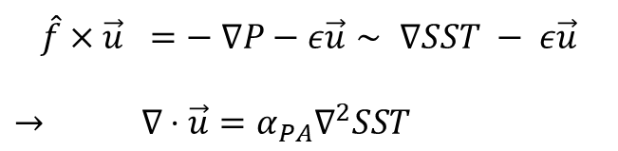
reinforced wind shear
TWO MAIN MABL RESPONSE MECHANISMS
Pressure Adjustment (PA)
Downward Momentum mixing (DMM)
$$\hat{f}×\vec{u} =− ∇P−ε\vec{u}∼ ∇SST − ε\vec{u}$$
$→ ∇⋅\vec{u}=α_{PA}∇^{2}SST$
$∂_{r}u_{r}=α_{DM} ∂_{r}SST$
low-Ro, weak wind conditions relative to front width
high-Ro, strong cross-frontal wind
neutral stability conditions
Notes:
DMM: Indeed, a wind blowing from cold to warm (warm tocold) SST favors the increase (decrease) of the air potentialtemperature and humidity and weakens (strengthens) the ver-tical wind shear, enhancing (inhibiting) the coupling with thewinds aloft; arguments from an analyti-cal model the wind response to an ocean front is asymmetric,with a more important DMM response for the cold-to-warmtransitions
PA mechanism, the air parcel thermodynamicallyadjusts to the underlying SST affecting air density and pres-sure; also shown to be asymmetric in over cold or warm patches
Been argued that coupling is stronger in winter, in line with the seasonality patterns seen before
DMM- and PA-mediated wind response can be disentangled by estimating re-sponse and transfer functions from satellite data
wind stress divergence results from either large-scale winds crossing the front or from a thermally direct, cross-frontal circulation

Slide 21
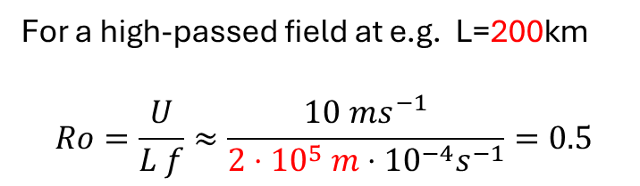
reinforced wind shear
TWO MAIN MABL RESPONSE MECHANISMS
low-Ro, weak wind conditions relative to front width
high-Ro, strong cross-frontal wind
neutral stability conditions
For a high-passed field at e.g. L=200km
$$Ro=\frac{U}{L f}≈\frac{10 ms^{−1}}{2⋅{10}^{5} m⋅{10}^{−4}s^{−1}}=0.5$$
RIGHT?
Notes:
Mechanisms unveiled here are valid for other structures (such as Kuroshio and Agulhas)
NOT TREATED: FEEDBACK ON THE OCEAN BY INDUCED CIRCULATION, ANOMALOUS EKMAN PUMPING
wind stress divergence results from either large-scale winds crossing the front or from a thermally direct, cross-frontal circulation

Slide 22
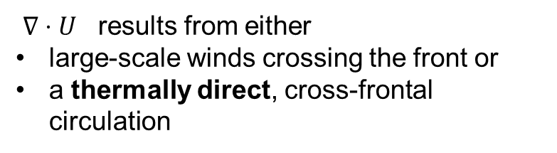
reinforced wind shear
TWO MAIN MABL RESPONSE MECHANISMS
low-Ro, weak wind conditions relative to front width
high-Ro, strong cross-frontal wind
neutral stability conditions
$∇⋅U$ results from either
large-scale winds crossing the front or
a thermally direct, cross-frontal circulation
… is this really the end?

Slide 23
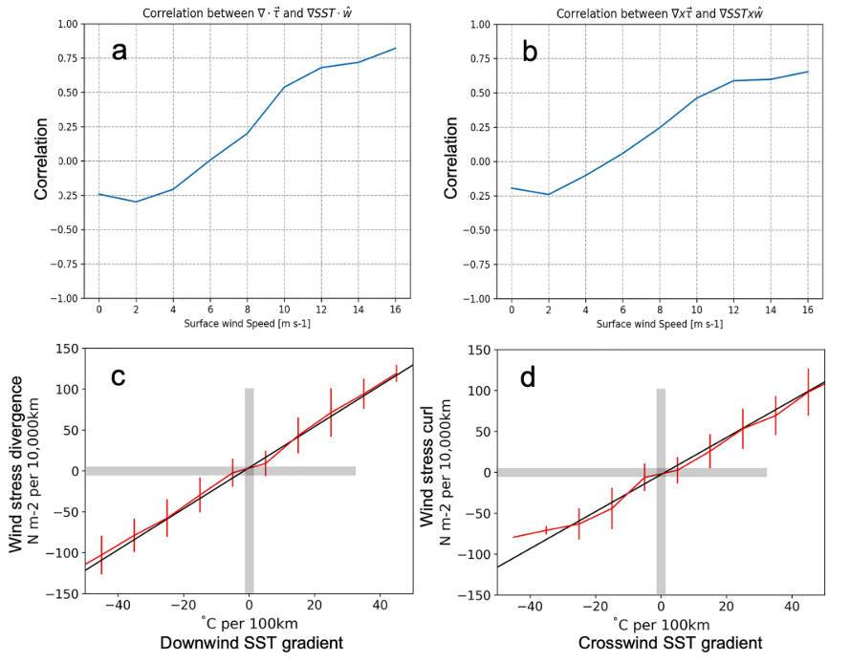
Clear positive correlations only for wind speeds > 5 m/s …
… confirmed by High-speed only correlations
→ Corr. coeff. much do depend on model resolution!
Strobach et al. 2022
Notes:
Atmo grid = 6km ; ocean grid = 3km
wind stress curl and divergence patterns are relatively stationary in space (above the SST fronts) which indicate their connection to the front

Slide 24
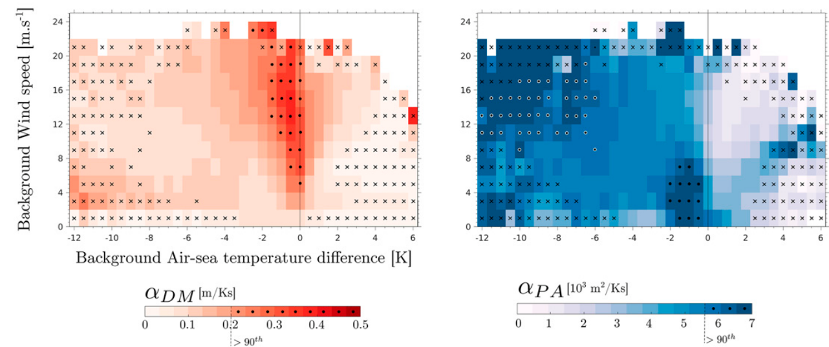
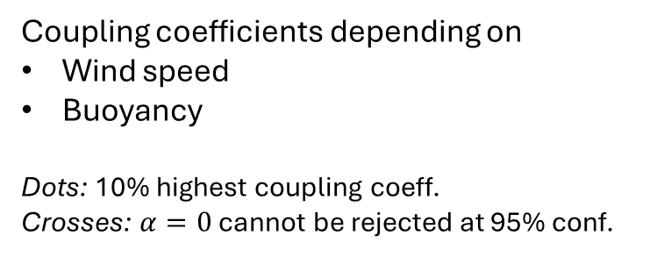
5
5
Coupling coefficients depending on
Wind speed
Buoyancy
Dots: 10% highest coupling coeff.
Crosses: $α=0$ cannot be rejected at 95% conf.
Strong coupling in
low-Ro conditions, as expected
Strong coupling in
high-speed and low-stability!
! Could be part of my work!
Desbiolles et al. 2023

Slide 25
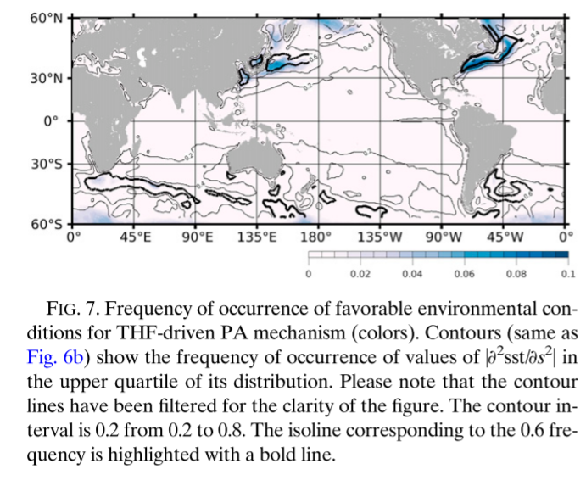

Slide 26
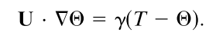
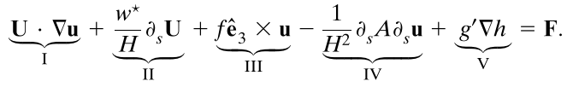
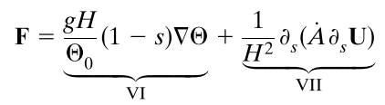
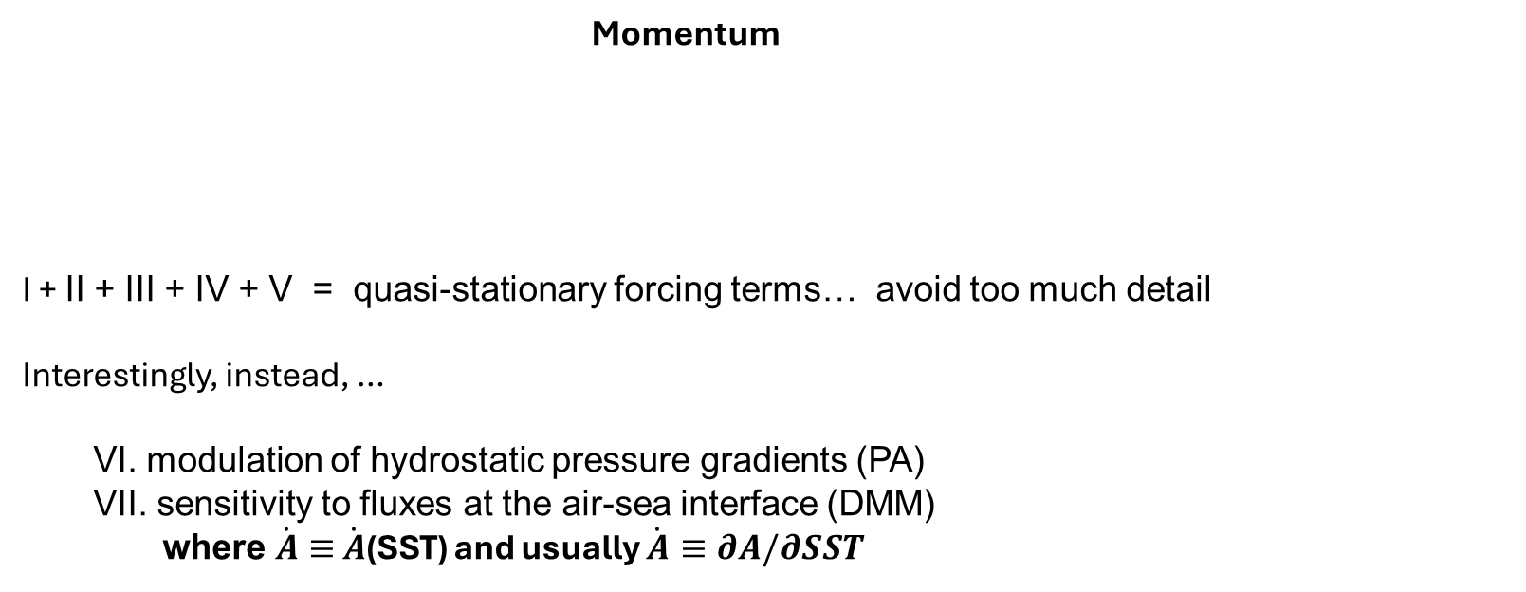
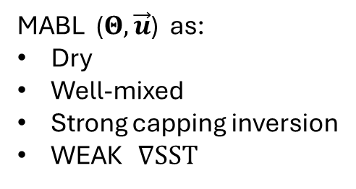
Schneider and Qiu 2015
Thermodynamics
balance between «buoyancy» and large-scale advection
MABL ($Θ, \vec{u}$) as:
Dry
Well-mixed
Strong capping inversion
WEAK $∇SST$
Momentum
I + II + III + IV + V = quasi-stationary forcing terms… avoid too much detail Interestingly, instead, …
VI. modulation of hydrostatic pressure gradients (PA) VII. sensitivity to fluxes at the air-sea interface (DMM)
where $\dot{A}≡$ $\dot{A}$(SST) and usually $\dot{A}≡∂A/∂SST$
Notes:
COLD ADVECTION OVER WARMER PATCHES!!!
SHOULD CHECK ABOUT VALIDITY: IS IT OK TO USE THESE EQUATIONS IN GS CONDITIONS?
I. SST-induced circulation advected by atmospheric mean wind II. vertical advection of LS vertical shear, H height of inversion III. Coriolis IV. divergence of vertical fluxes due to LS mixing V. hydrostatic adjustment of inversion height due to oceanic mesoscale
VI. modulation of hydrostatic pressure gradients (PA) VII. sensitivity to fluxes at the air-sea interface (DMM)

Slide 27





BUT
No specific inclusion of moisture
→ LHF are much larger than SHF (2.5 times or more) and do contribute to onset of circulation (e.g. CLIMODE 2009)
heat fluxes are also maintained by the inflation of MABL and the dry entrainment following.
C
W
Heat budget + PA [+ DMM]
→ Development of solenoidal circulation which can be advected downstream
warm meander
! could we use HR sim to look at horizontal vorticity?
Notes:
Surface-driven solenoidal circulations occur whenmesoscale gradients in the surface heat ﬂux lead to hor-izontal mesoscale gradients in boundary layer temper-ature

Slide 28
How about clouds?

Slide 29
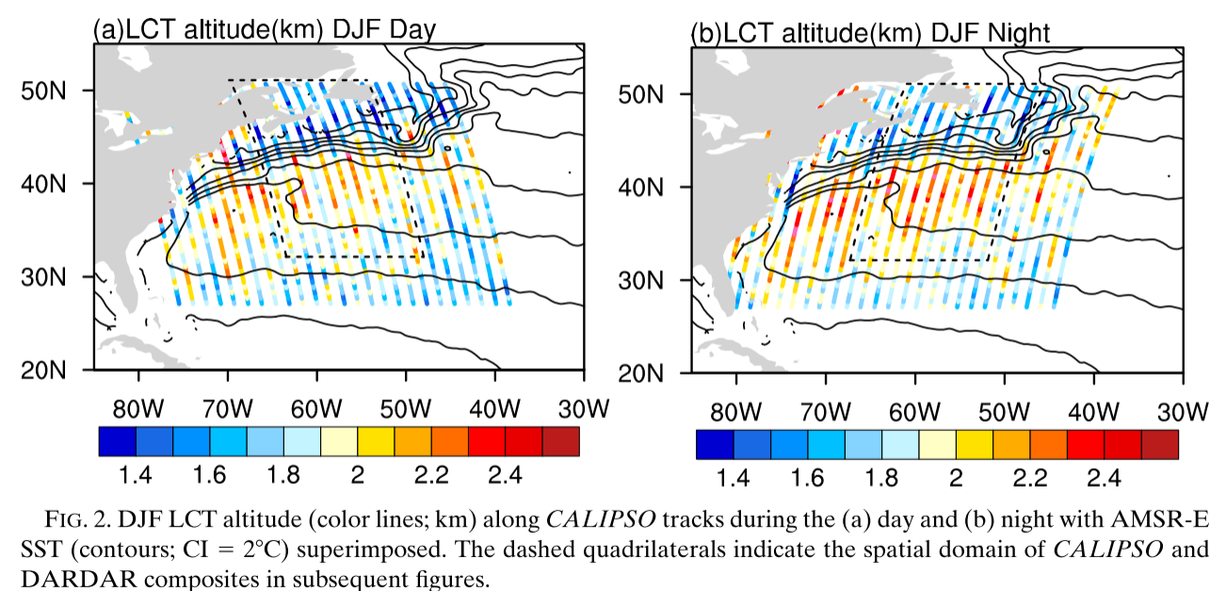
Winter daily cycle in low-level cloud tops
Liu et al. 2014
Notes:
In general, LCT is higherat night, indicative of a deeper MABL. This is because theentrainment is strengthened by infrared radiation coolingat cloud top at night, but solar radiation weakens this effectin the day
Farther to the south away from the Gulf Stream, the gradual southward decrease ofLCT from 358N is due to large-scale subsidence of thesubtropical high

Slide 30
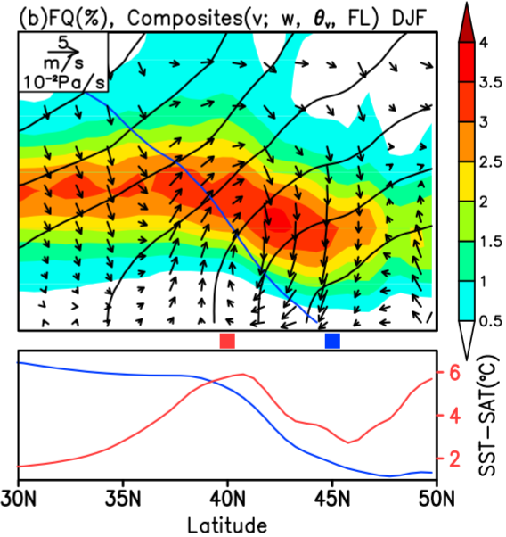
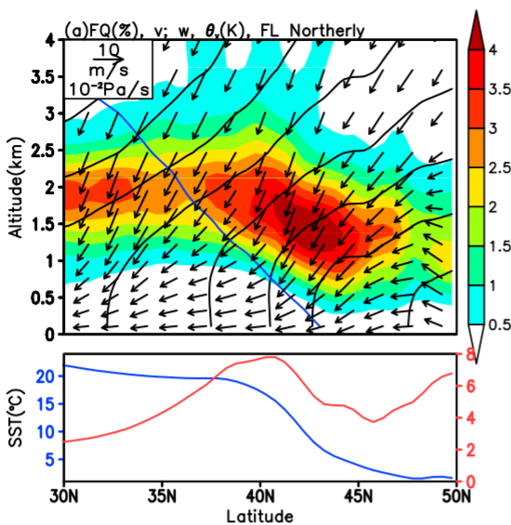
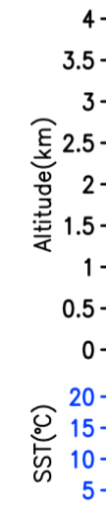
Climatology for northerly flow conditions
→importance of warm SST in attenuating large scale subsidence
Full seasonal climatology of profiles
→ nonetheless, more than 50% of the cases involve a northerly flow
Liu et al. 2014
Notes:
Fields reconstructed with ERA Interim WITHOUT HIGH-PASS FILTER!
LEFT: - blu line = freezing level
- black contours = theta
The former peak of SST - SAT is becausethe atmospheric adjustment to the SST front is slowerthan the increase of SST when the MABL is advected bythe northerly wind from the cold to the warm water. Thelatter peak reﬂects the huge surface air temperaturecontrast between the ocean and continent in winter
the cross-frontal transition of low-levelclouds is more prevalent under surface northerlies
Theresulting cold advection intensiﬁes heat and moistureﬂux out of the ocean to the atmosphere, and thus favorsthe formation of stratocumulus

Slide 31
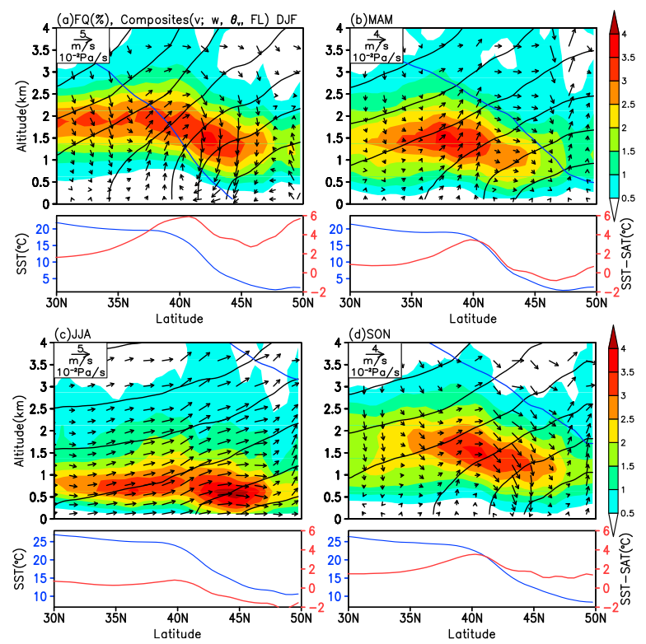
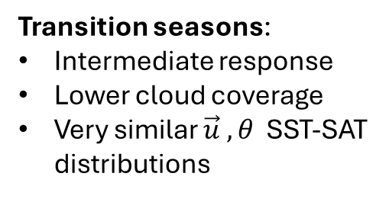
Transition seasons:
Intermediate response
Lower cloud coverage
Very similar $\vec{u} , θ$ SST-SAT distributions
Summer:
More frequent southerly flow
→ MABL stabilization
Much lower cloud coverage vs. DJF
Liu et al. 2014

Slide 32
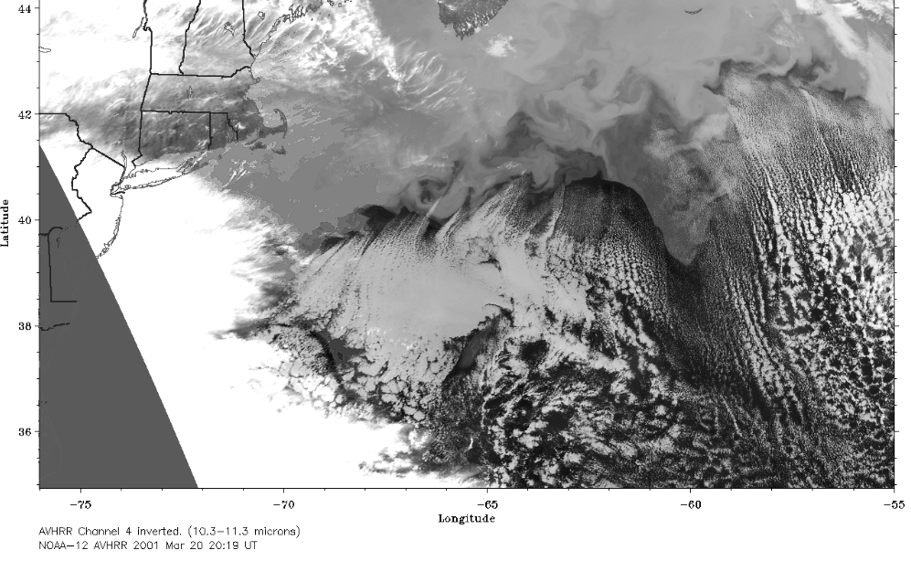
Young and Sikora 2003, fig. 12
Notes:
some of these cloud lines appear to trigger from small-scale hot spotswhere minor eddies disrupt the North Wall. Thus, cloudlines of the same size and shape appear to be arising inthe same synoptic setting from both the wide-mode con-vective roll mechanism and the solenoidal-circulationmesoscale band mechanism.

Slide 33
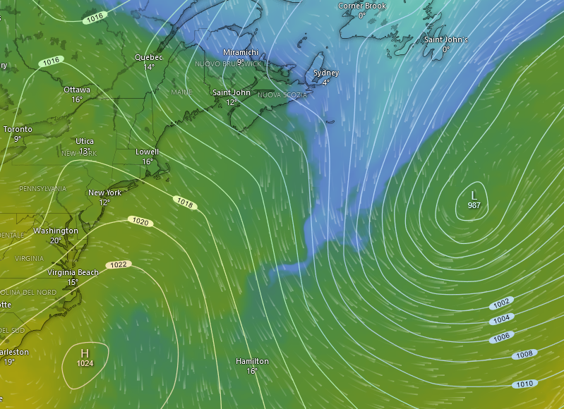
Perfect timing!
CA
MSLP and 850hPa Temperature
09.04.2024 0000Z
GS
Source: windy.com

Slide 34
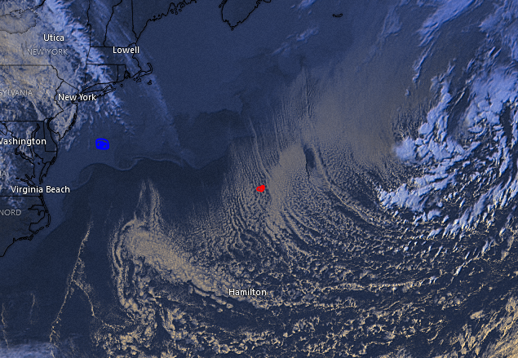
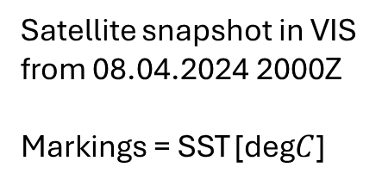
Satellite snapshot in VIS from 08.04.2024 2000Z
Markings = SST [deg$C$]
10
20
Source: windy.com

Slide 35
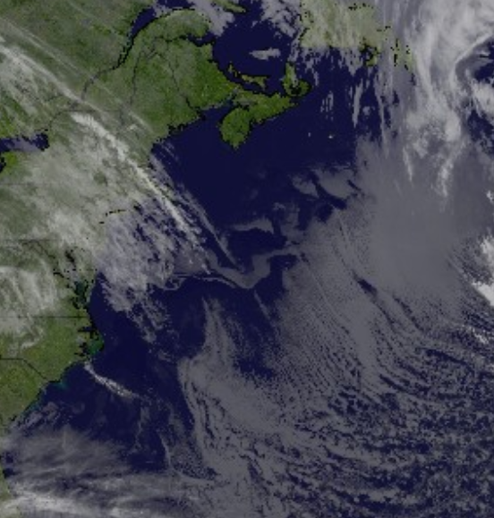
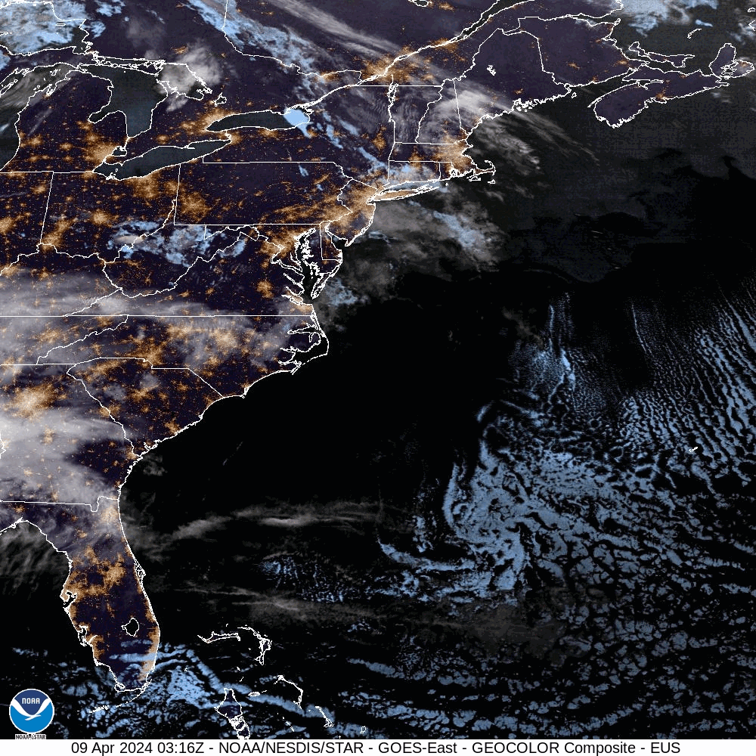
09.04.2024 - Early morning
-> fog patches at the SST front: Northern Wall

Slide 36








MSLP and 850hPa Temperature
11.04.2024 1700Z
… and again on 11.04
CA
WA
GS
GS

Slide 37









GS

Slide 38
Satellite snapshot in VIS from 08.04.2024 2000Z
Markings = SST [deg$C$]
10
20
Source: windy.com

Slide 39


WARM
COLD
Notes:
Cloud streets originating from Vertical advection in an unstable BL, not from localized variations in Sfc HF
Notice changes in CCL!

Slide 40
















CCL: quick revision
WARM
COLD
$$CCL$$
$$CCL$$
$$T_{\begin{aligned}DEW \\ SFC \end{aligned}}$$
$$T_{CONV}$$
$$T_{\begin{aligned}DEW \\ SFC \end{aligned}}$$
$$T_{CONV}$$
Notes:
Cloud streets originating from Vertical advection in an unstable BL, not from localized variations in Sfc HF
Notice changes in CCL!

Slide 41

Vertical cross section of
meridional velocity anomaly (shades)
Full vertical velocity (arrows)
MABL (dotted)
during a cold front passage!
→ Northerly flow climatology in Liu et al. 2014 is in line with high-res coupled simulations!
Strobach et al. 2022

Slide 42


Slide 43


Slide 46


What are the low-level clouds composed of?
Corresponding climatologies for cloud types as retrieved from DARDAR-MASK
→ This product combines remote sensing outputs from CloudSat, CALIPSO and MODIS
Liu et al. 2014
Notes:
DARDAR-MASK that combinesCloudSat, CALIPSO,and MODIS

Slide 47


Notes:
-> Mechanisms unveiled here are valid for other structures (such as Kuroshio and Agulhas)

Slide 48

Yo Ocean, long time no sea!
What up with your current affairs?
Hey Atmo! What good wind blows you over?

Slide 49

Trapped
Lee
Waves!

Slide 50

Gap flows!

